Slide 1
_{Talker jz}
_{Fun}
_{with}

Slide 2
Preview

Slide 3
5

Slide 4
Talk
With you

Slide 5
Chinese
In

Slide 6

Reader

Slide 7
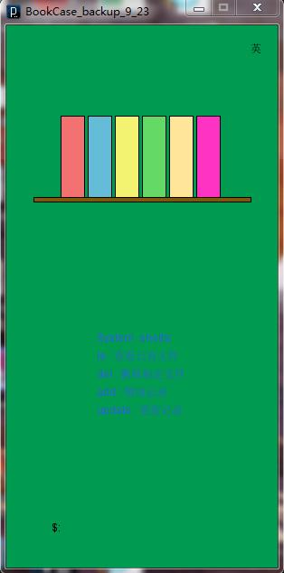
Recorder

Slide 8
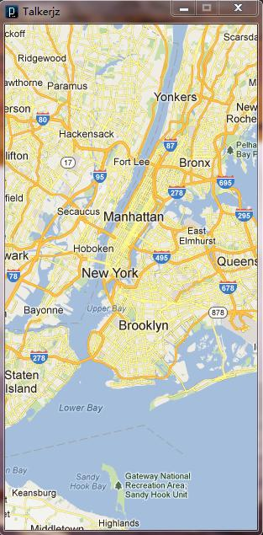
Talker Map

Slide 9
Demo

Slide 10
Thank you

